Slide 1
Lecture 1 – Course Overview
CST370 – Design & Analysis of Algorithms
Dr. Byun
Computer Science

Slide 2
Lecture Objectives
After completion of this lecture, you will be able to
  identify general policy of this course.

Slide 3
Course Information
Refer to Course Syllabus
  http://ilearn.csumb.edu
Credits: 4.0
Prerequisites
  CST 238 or instructor's consent
Lectures
  Sec1: TR, 10:00A – 11:50A, BIT, Room 224
  Sec2: TR, 2:00P – 3:50P, BIT, Room 110

Slide 4
Instructor
Name: YoungJoon Byun, Ph.D.
Email: ybyun@csumb.edu
Phone: 831-582-3602
Zoom: https://csumb.zoom.us/j/4457737239
Office: BIT Building/Room 209
Office hours:
  Tuesday 1:00P – 2:00P
  Tuesday 4:30P – 5:30P
  Thursday 1:00P – 2:00P
  Or by appointment

Slide 5
Email Contact
Email is always welcome.
  Put [CST370] at the beginning of subject line
Sample
  To: ybyun@csumb.edu
  Subject: [CST370] Homework1 solution?
  Content:
  Dr. Byun,
  At the class, you said that you posted the solution of homework 1 on the iLearn. But I can’t find it. Where is the solution?
  [Your name]

Slide 6
Course Web Site
http://iLearn.csumb.edu/
  Additional course information and announcements will be posted here.
  Check frequently.

Slide 7
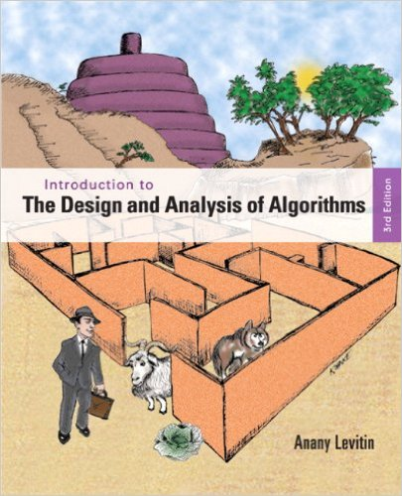
Strongly Recommended Textbook
Author: Anany Levitin
Title: Introduction to the Design and Analysis of Algorithms, 3rd Edition
Publisher: Addison Wesley, 2011
ISBN: 978-0132316811

Slide 8

Recommended Reference
Author: Anany Levitin and Maria Levitin
Title: Algorithmic Puzzles
Publisher: Oxford University Press, 1st edition
ISBN: 978-0199740444

Slide 9
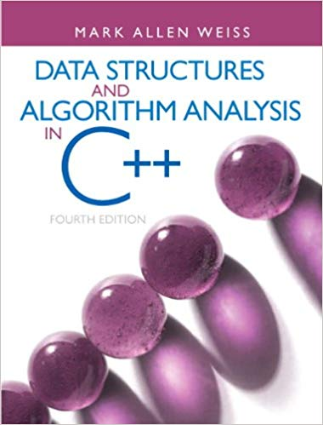
Recommended Reference
Author: Mark Allen Weiss
Title: Data Structures and Algorithm Analysis in C++
Publisher: Pearson
ISBN: 978-0132847377

Slide 10
Main Objectives
Acquire algorithm design techniques
  Brute force
  Divide-and-conquer
  Greedy method
  etc.
Learn important data structures
  Hash, heap, tree, graph, etc.
Analyze efficiency of algorithms

Slide 11
Course Outcomes
After finishing this course, you should be able to
  Measure the efficiency of an algorithm and use asymptotic notations to represent the efficiency.
  Understand important algorithm design techniques such as brute-force, divide-and-conquer, decrease-and-conquer, transform-and-conquer, greedy method, and dynamic programming.
  Explain different sorting techniques such as heapsort, merge sort, and quick sort.
  Describe tree and graph-based algorithms such as depth-first search, breadth-first search, minimum spanning trees, and shortest path algorithms.
  Introduce computational complexity and P & NP concept.

Slide 12
Main Topics
Review of fundamental data structures
Analysis of algorithm efficiency
Brute-force algorithm design technique
Divide-and-conquer
Decrease-and-conquer
Transform-and-conquer
Space and time tradeoffs
Graph algorithms
Dynamic programming
Greedy method
P & NP
Advanced topics, if time permitted

Slide 13
Exams
Two midterms
  Feb. 27 and Apr. 9 in class
Final exam
  May 12 in class.
  Final exam will be comprehensive.
All exams are closed book/note.
No re-grading will be accepted one week after grading is returned to students.
No makeup, except extreme emergency cases.

Slide 14
Quizzes
Irregular quizzes in class.
Exact date will be announced in advance.
No makeup for quizzes.
No re-grading will be accepted one week after grading is returned.

Slide 15
Homework
Problem solving and programming assignments will be given throughout the semester.
No late submission will be accepted.
No re-grading will be accepted one week after grading is returned.

Slide 16
Grading Policy
Midterm – I | 15%
Midterm – II | 15%
Final Exam | 15%
Quiz | 10%
Homework | 45%
Grade
A+ | 100 | 94 ≥
A | 94 < | 90 ≥
A- | 90 < | 87 ≥
B+ | 87 < | 84 ≥
B | 84 < | 80 ≥
B- | 80 < | 77 ≥
C+ | 77 < | 73 ≥
C | 73 < | 67 ≥
D | 67 < | 57 ≥
F | 57 < | 0

Slide 17
Attendance
Students are expected to be regular and punctual in class attendance.
  Students are responsible for all materials covered in the lectures.
If you miss four times in the lectures, you will get 10% cut from your final grading.
  After that, you will continue to receive an additional 5% cut for a following miss.

Slide 18
Note to Students with Disabilities
Students with disabilities who may need accommodations
  Please see me as soon as possible during the office hour or make an appointment
Also, contact:
  Student_Disability_Resources@csumb.edu
  Building 47, Student Services, First Floor
  Phone: 831/582-3672 voice, or 582-4024 fax/TTY
  http://csumb.edu/sdr

Slide 19
Academic Integrity Policy
Cheating of any kind will not be tolerated.
  You are responsible for your own original work on all assignments, homework, quizzes, exams, and all programming code.
  Two or more students who submit extremely similar code will receive a zero score on the assignment.
  Furthermore, the students will be reported to the academic dishonesty board.
  There are continual checks of the assignments to be sure that everyone is handing in original code.
  https://csumb.edu/policy/academic-integrity-policy

Slide 20
Your Class ID Number
To handle your homework, quiz, and exam more efficiently, we require you to choose your class ID number.
  The number should be a four-digit integer number.
  We will use the number for only the class.
I will circulate a paper to write your class ID.
  Avoid duplication. If a number which is already selected by another student, choose a different number.

Slide 21
Homework Programming
For the programming assignment, you have to use the C++ programming language.
  For the first homework, you can use either C++ or Java.
  But from the homework 2, you must use only the C++.

Slide 22
repl.it
We will use repl.it for the programming in the course.
  If you don’t have an account at repl.it, go to https://repl.it and create one.
Example repl
  https://repl.it/@YBYUN/HelloCST370

Slide 23
sample.cpp
/*
* Title: sample.cpp
* Abstract: This program displays Hello World on the screen.
* Author: Dr. Byun [In your case, you should write your name.]
* ID: 8899 [In your case, use your four-digit number for the class]
* Date: MM/DD/YYYY [Write the date you write this program.]
*/
#include <iostream>
using namespace std;
int main()
{
cout << "Hello World!\n";
return 0;
}

Slide 24
Algorithmic Puzzle
In the course, we will talk about a few algorithmic puzzles that are interesting problems related to algorithms.
  They are an important part of our lectures.
Sometimes, we will discuss a puzzle that is not directly related to the algorithm we cover.
  However, the puzzle is frequently mentioned at a technical job interview.

Slide 25
A River Crossing Puzzle
A farmer finds himself on a riverbank with a wolf, a goat, and a head of cabbage.
  He needs to transport all three to the other side of the river in his boat.
  However, the boat has room for only the farmer himself and one other item (either the wolf, the goat, or the cabbage). In his absence, the wolf would eat the goat, and the goat would eat the cabbage.
  Solve this problem for the farmer or prove it has no solution.

Slide 26
Solution

Slide 27
River Crossing Puzzle: Advanced Version
There are four people who want to cross a bridge. You have 17 minutes to get them all across to the other side.
  It is night, and they have one flashlight.
  A maximum of two people can cross the bridge at one time. Any party that crosses must have the flashlight with them.
  Person A takes 1 minute to cross the bridge, person B takes 2 minutes, person C takes 5 minutes, and person D takes 10 minutes.
  A pair must walk together at the rate of the slower person’s pace. For example, if person A and person D walk across together, it will take 10 minutes to get to the other side of the bridge.

Slide 28
Solution

